Slide 1



PROJECT MANAGEMENT IN PRACTICE
Project Risk Management
Lecture No: 13 Week: 7
Vispi Shroff
Sub Heading
And Date

Slide 2

Recap
Importance of Risk
Overview of the Risk Management Process
Planning Risk Management
Identifying Risks

Slide 3
Today’s Topics & Learning Outcomes
Quantitative Risk Analysis
Qualitative Risk Analysis
Risk Response Planning Strategies
Monitoring & Controlling Risk

Slide 4
Risk Register
Main output from Risk Identification processes
A risk register is:
- A document that contains the results of various risk management processes and that is often displayed in a table or spreadsheet format
- A tool for documenting potential risk events and related information
Risk Register Contents
ID No, Name, Description, Category, Root Cause, Triggers (indicators or symptoms of a risk event occurring), Potential Responses, Risk Owner, Probability, Impact & Status

Slide 5
Qualitative Risk Assessment
- Assess the likelihood and impact of identified risks to determine their magnitude and priority
- Risk quantification tools and techniques include:
- Probability/impact matrixes
- The Top Ten Risk Item Tracking
- Expert judgment

Slide 6
Probability Matrices
- A probability/impact matrix or chart lists the relative probability of a risk occurring on one side of a matrix or axis on a chart and the relative impact of the risk occurring on the other
- List the risks and then label each one as high, medium, or low in terms of its probability of occurrence and its impact if it did occur
- Can also calculate risk factors
- Numbers that represent the overall risk of specific events based on their probability of occurring and the consequences to the project if they do occur

Slide 7
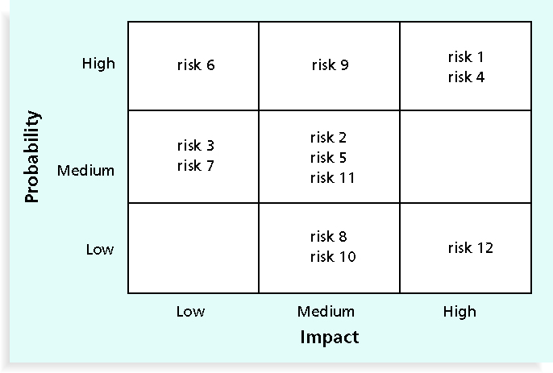
Probability/Impact Matrix

Slide 8
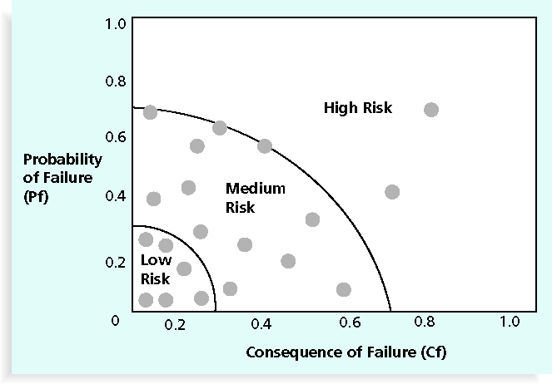
Probability/Consequence of Failure Chart

Slide 9
Top-Ten Risk Item Tracking
- Top Ten Risk Item Tracking is a qualitative risk analysis tool that helps to identify risks and maintain an awareness of risks throughout the life of a project
- Establish a periodic review of the top ten project risk items
- List the current ranking, previous ranking, number of times the risk appears on the list over a period of time, and a summary of progress made in resolving the risk item

Slide 10
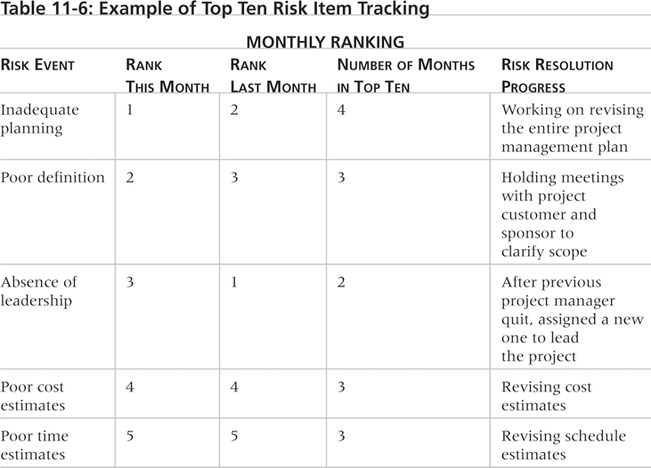
Example

Slide 11
Quantitative Risk Analysis
- Often follows qualitative risk analysis, but both can be done together
- Large, complex projects involving leading edge technologies often require extensive quantitative risk analysis
- Main techniques include:
- Decision tree analysis
- Simulation: Uses a model of a system to analyze expected behavior or performance of a system.
- Sensitivity analysis

Slide 12
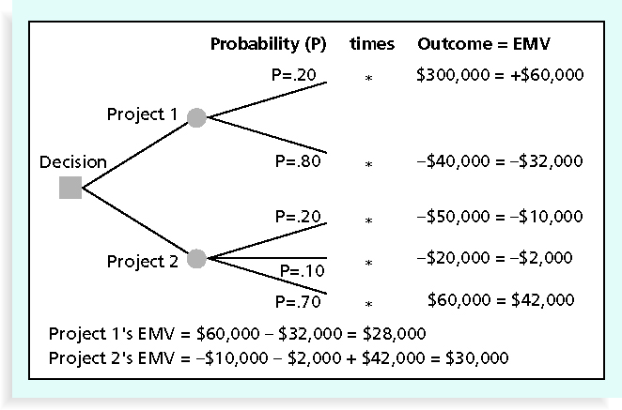
Decision Tree Analysis

Slide 13
Sensitivity Analysis
- Sensitivity analysis is a technique used to show the effects of changing one or more variables on an outcome
- For example, many people use it to determine what the monthly payments for a loan will be given different interest rates or periods of the loan, or for determining break-even points based on different assumptions
- Spreadsheet software, such as Excel, is a common tool for performing sensitivity analysis

Slide 14
Planning Risk Responses
Four main response strategies for
Negative Risks | Positive Risks
Risk avoidance Risk acceptance Risk transference Risk mitigation | Risk exploitation Risk sharing Risk enhancement Risk acceptance

Slide 15
Monitoring & Controlling Risk
- Involves executing the risk management process to respond to risk events
- Workarounds are unplanned responses to risk events that must be done when there are no contingency plans
- Main outputs of risk monitoring and control are:
- Risk register updates
- Organizational process assets updates
- Change requests
- Updates to the project management plan and other project documents

Slide 16
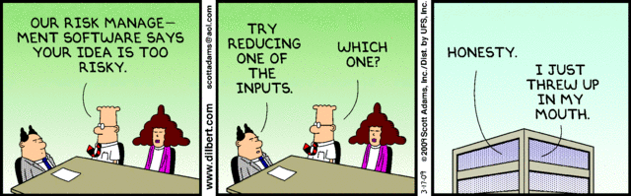
Any Thoughts, Questions, Ideas?

Slide 17
Reading Materials for the Week
Schwalbe, K., 2007. Information Technology Project Management 5th ed., United States of America: Thomson Course Technology. Chapter 12
PMBOK Guide, Chapter 12

Slide 18
Conclusions
Good Project Risk Management results
- Unlike crisis management, good project risk management often goes unnoticed
- Well-run projects appear to be almost effortless, but a lot of work goes into running a project well
- Project managers should strive to make their jobs look easy to reflect the results of well-run projects

Slide 19
References
Schwalbe, K., 2007. Information Technology Project Management 5th ed., United States of America: Thomson Course Technology. Chapter 11
PMBOK Guide, Chapter 11

